Slide 1
Chapter 2
The Recording Process

Slide 2
CHAPTER 2 THE RECORDING PROCESS
After studying this chapter, you should be able to:
1 Explain what an account is and how it helps in the recording process
2 Define debits and credits and explain how they are used to record business transactions
3 Identify the basic steps in the recording process
4 Explain what a journal is and how it helps in the recording process

Slide 3
CHAPTER 2 THE RECORDING PROCESS
After studying this chapter, you should be able to:
5 Explain what a ledger is and how it helps in the recording process
6 Explain what posting is and how it helps in the recording process
7 Prepare a trial balance and explain its purpose

Slide 4
THE ACCOUNT
STUDY OBJECTIVE 1
An account is an individual accounting record of increases and decreases in a specific asset, liability, or owner’s equity item.
There are separate accounts for the items we used in transactions such as cash, salaries expense, accounts payable, etc.

Slide 5
BASIC FORM OF ACCOUNT
STUDY OBJECTIVE 2
The simplest form an account consists of
1 the title of the account
2 a left or debit side
3 a right or credit side
The alignment of these parts resembles the letter T = T account
Title of Account
Left or debit side
Right or credit side
Debit balance
Credit balance

Slide 6
DEBITS AND CREDITS
Debit indicates left and Credit indicates right
Recording $ on the left side of an account is debiting the account
Recording $ on the right side is crediting the account
If the total of debit amounts is bigger than credits, the account has a debit balance
If the total of credit amounts is bigger than debits, the account has a credit balance

Slide 7
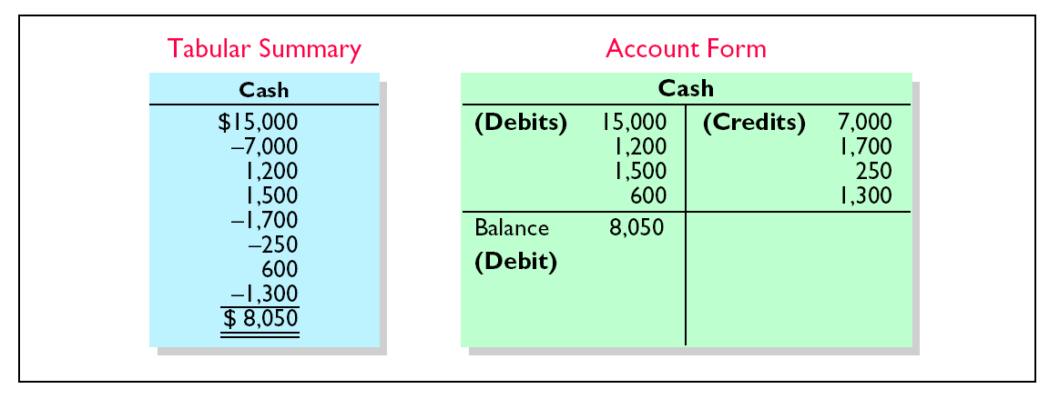
TABULAR SUMMARY COMPARED TO ACCOUNT FORM

Slide 8
DEBITING AN ACCOUNT
Cash
Debits
Credits
15,000
Example: The owner makes an initial investment of $15,000 to start the business. Cash is debited as the owner’s Capital is credited.

Slide 9
CREDITING AN ACCOUNT
Cash
Debits
Credits
7,000
Example: Monthly rent of $7,000 is paid. Cash is credited as Rent Expense is debited.

Slide 10
DEBITING / CREDITING AN ACCOUNT
Cash
Debits
Credits
15,000
7,000
8,000
Example: Cash is debited for $15,000 and credited for $7,000, leaving a debit balance of $8,000.

Slide 11


DOUBLE-ENTRY SYSTEM
equal debits and credits made accounts for each transaction
total debits always equal the total credits
accounting equation always stays in balance
Assets
Liabilities
Equity
Notes:
Fix the Equation Assets = Liabilities + Equity.

Slide 12
DEBIT AND CREDIT EFFECTS — ASSETS AND LIABILITIES
Debits
Credits
Increase assets Decrease assets
Decrease liabilities Increase liabilities

Slide 13
NORMAL BALANCE
every account has a designated normal balance.
  It is either a debit or credit.
accounts rarely have an abnormal balance.

Slide 14


NORMAL BALANCES — ASSETS AND LIABILITIES
Assets
Increase Decrease Debit Credit
Normal Balance
Liabilities
Decrease Increase Debit Credit
Normal
Balance

Slide 15
DEBIT AND CREDIT EFFECTS — OWNER’S CAPITAL
Debits
Credits
Decrease owner’s capital Increase owner’s capital

Slide 16
NORMAL BALANCE — OWNER’S CAPITAL
Owner’s Capital
Decrease Increase Debit Credit
Normal Balance

Slide 17
DEBIT AND CREDIT EFFECTS — OWNER’S DRAWING
Debits
Credits
Increase owner’s drawing Decrease owner’s drawing
Remember, Drawing is a contra-account – an account that is backwards from the account it accompanies (the Capital account).

Slide 18
NORMAL BALANCE — OWNER’S DRAWING
Owner’s Drawing
Increase Decrease Debit Credit
Normal Balance

Slide 19
DEBIT AND CREDIT EFFECTS — REVENUES AND EXPENSES
Debits
Credits
Decrease revenues Increase revenues
Increase expenses Decrease expenses

Slide 20
NORMAL BALANCES — REVENUES AND EXPENSES
Revenues
Decrease Increase Debit Credit
Normal
Balance
Expenses
Increase Decrease Debit Credit
Normal
Balance

Slide 21
EXPANDED BASIC EQUATION AND DEBIT/CREDIT RULES AND EFFECTS
Assets
=
Liabilities
+
Owner’s Equity
Owner’s Capital
Owner’s Drawing
Assets
=
Liabilities
+
-
Dr.
Cr.
Dr.
Cr.
Dr.
Cr.
Dr.
Cr.
+ -
- +
- +
+ -
+
Revenues
-
Expenses
Dr.
Cr.
Dr.
Cr.
- +
+ -

Slide 22
Which of the following is not true of the terms debit and credit.
  a. They can be abbreviated as Dr. and Cr.
  b. They can be interpreted to mean increase and decrease.
  c. They can be used to describe the balance of an account.
  d. They can be interpreted to mean left and right.

Slide 23
Which of the following is not true of the terms debit and credit.
  They can be abbreviated as Dr. and Cr.
  They can be interpreted to mean increase and decrease.
  They can be used to describe the balance of an account.
  They can be interpreted to mean left and right.

Slide 24
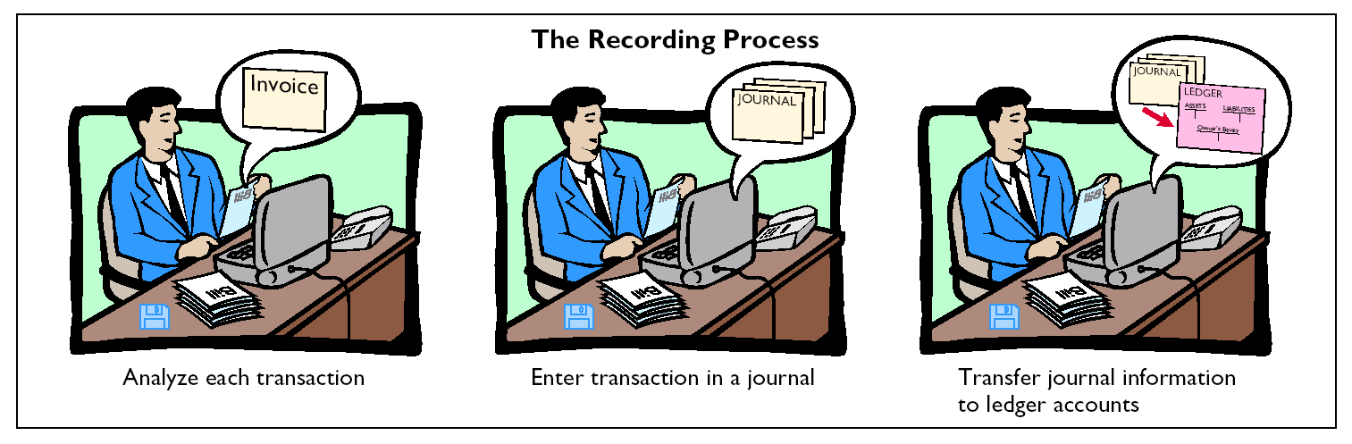
THE RECORDING PROCESS
STUDY OBJECTIVE 3
1 analyze each transaction (+, -)
2 enter transaction in a journal
3 transfer journal information to ledger accounts

Slide 25
THE JOURNAL
STUDY OBJECTIVE 4
Transactions
  Are initially recorded in chronological order before they are transferred to the ledger accounts.
A general journal has
1 spaces for dates
2 account titles and explanations
3 references
4 two amount columns

Slide 26
THE JOURNAL
A journal makes several contributions to recording process:
1 discloses in one place the complete effect of a transaction
2 provides a chronological record of transactions
3 helps to prevent or locate errors as debit and credit amounts for each entry can be compared

Slide 27
JOURNALIZING
Entering transaction data in the journal is known as journalizing.
Separate journal entries are made for each transaction.
A complete entry consists of:
1 the date of the transaction,
2 the accounts and amounts to be debited and credited,
3 a brief explanation of transaction.

Slide 28
TECHNIQUE OF JOURNALIZING
The date of the transaction is entered into the date column.
GENERAL JOURNAL
J1
Date
Account Titles and Explanation
Ref.
Debit
Credit
2005
Sept. 1
Cash
15,000
R. Neal, Capital
15,000
(Invested cash in business)
1
Computer Equipment
7,000
Cash
7,000
(Purchased equipment for
cash)

Slide 29
TECHNIQUE OF JOURNALIZING
The debit account title is entered at the extreme left margin of the Account Titles and Explanation column. The credit account title is indented on the next line.
GENERAL JOURNAL
J1
Date
Account Titles and Explanation
Ref.
Debit
Credit
2005
Sept. 1
Cash
15,000
R. Neal, Capital
15,000
(Invested cash in business)
1
Computer Equipment
7,000
Cash
7,000
(Purchased equipment for
cash)

Slide 30
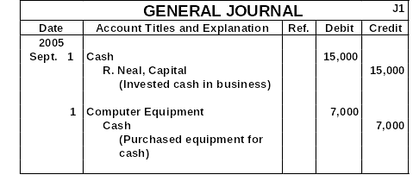
TECHNIQUE OF JOURNALIZING
The amounts for the debits are recorded in the Debit column and the amounts for the credits are recorded in the Credit column.

Slide 31

TECHNIQUE OF JOURNALIZING
A brief explanation of the transaction is given.

Slide 32
TECHNIQUE OF JOURNALIZING
A space is left between journal entries. The blank space separates individual journal entries and makes the entire journal easier to read.
GENERAL JOURNAL
J1
Date
Account Titles and Explanation
Ref.
Debit
Credit
2005
Sept. 1
Cash
15,000
R. Neal, Capital
15,000
(Invested cash in business)
1
Computer Equipment
7,000
Cash
7,000
(Purchased equipment for
cash)

Slide 33
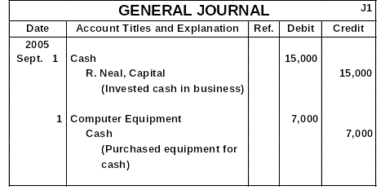
TECHNIQUE OF JOURNALIZING
The column entitled Ref. is left blank at the time journal entry is made and is used later when the journal entries are transferred to the ledger accounts.

Slide 34
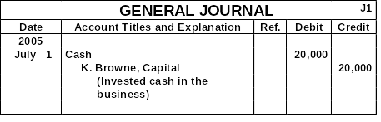
SIMPLE AND COMPOUND JOURNAL ENTRIES
If an entry involves only two accounts, one debit and one credit, it is considered a simple entry.

Slide 35
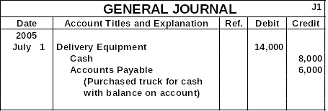
COMPOUND JOURNAL ENTRY
When three or more accounts are required in one journal entry, the entry is referred to as a compound entry.
1
2
3

Slide 36
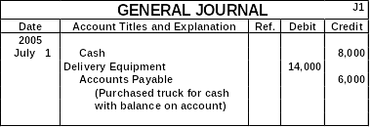
COMPOUND JOURNAL ENTRY
This is the wrong format; all debits must be listed before the credits are listed.

Slide 37
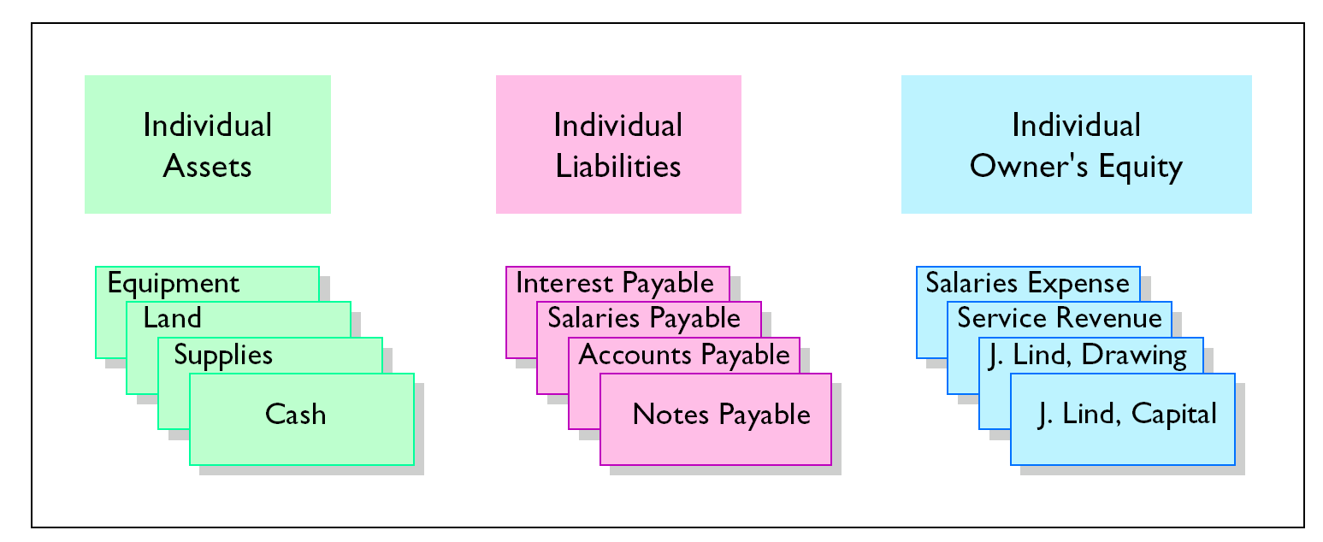
THE LEDGER
STUDY OBJECTIVE 5
A Group of accounts maintained by a company is called the ledger.
  A general ledger contains all the assets, liabilities, and owner’s equity accounts

Slide 38
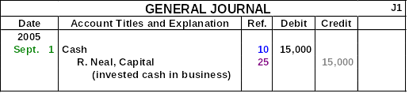
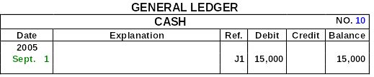
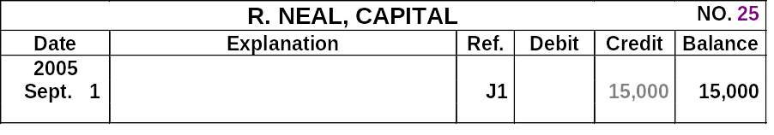
POSTING A JOURNAL ENTRY
In the ledger, enter in the appropriate columns of the account(s) debited the date, journal page, and debit amount shown in the journal.

Slide 39
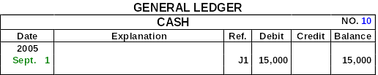

POSTING A JOURNAL ENTRY
In the reference column of the journal, write the account number to which the debit amount was posted.

Slide 40
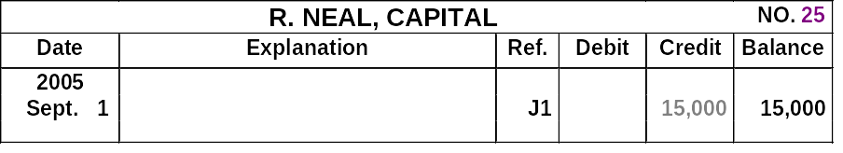
POSTING A JOURNAL ENTRY
GENERAL LEDGER
CASH
NO.
10
Date
Explanation
Ref.
Debit
Credit
Balance
2005
Sept. 1
J1
15,000
15,000
In the ledger, enter in the appropriate columns of the account(s) credited the date, journal page, and credit amount shown in the journal.
Notes:
This needs some rework.

Slide 41
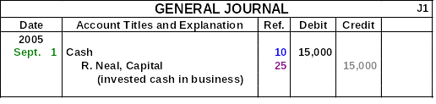
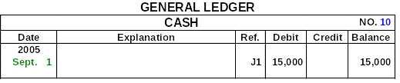

POSTING A JOURNAL ENTRY
In the reference column of the journal, write the account number to which the credit amount was posted.

Slide 42
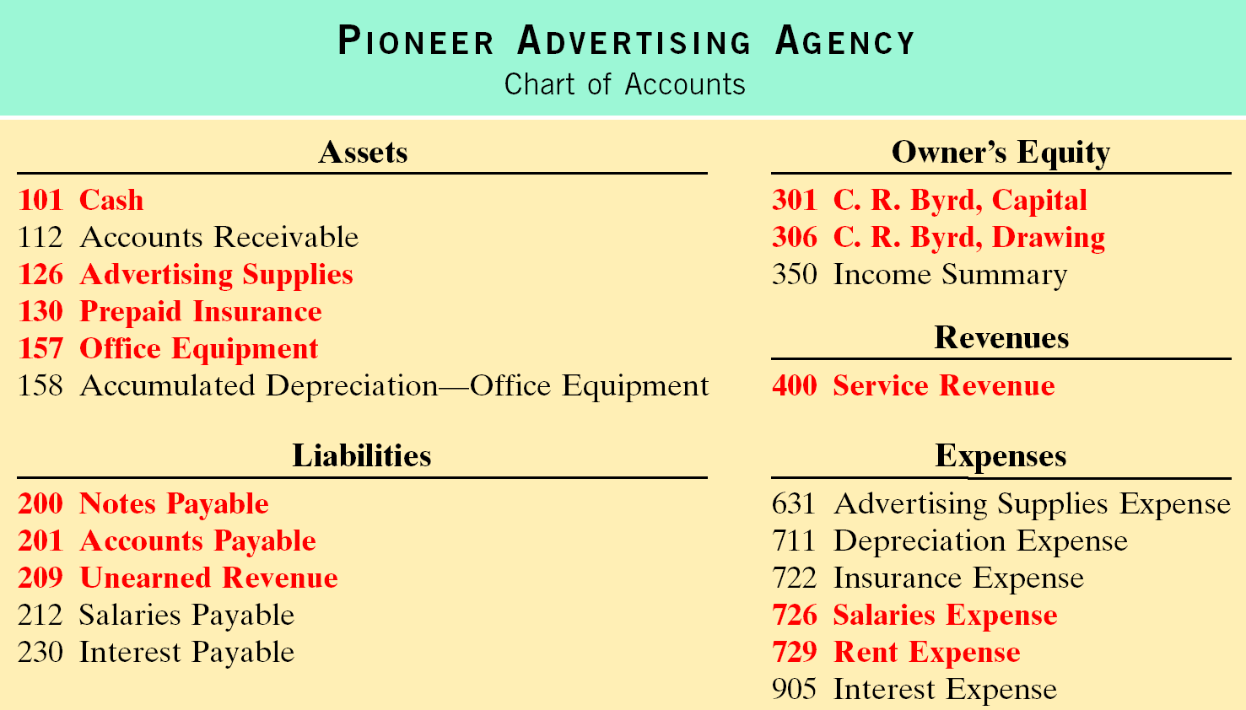
CHART OF ACCOUNTS
A Chart of Accounts lists the accounts and the account numbers which identify their location in the ledger.

Slide 43
INVESTMENT OF CASH BY OWNER
October 1, C.R. Byrd invests $10,000 cash in an advertising business known as:
The Pioneer Advertising Agency.
Transaction
Basic
Analysis
The asset Cash is increased $10,000
Owner’s equity, C. R. Byrd, Capital is increased $10,000.
Debit-Credit
Analysis
Debits increase assets: debit Cash $10,000.
Credits increase owner’s equity: credit C.R. Byrd,
Capital $10,000.

Slide 44
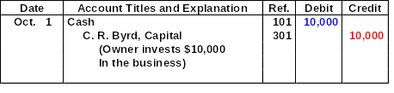


PURCHASE OF OFFICE EQUIPMENT
JOURNAL ENTRY
POSTING

Slide 45
INVESTMENT OF CASH BY OWNER
October 1, C. R. Byrd purchases $5,000 of equipment by issuing a 3-month, 12% note payable.
Transaction
Basic
Analysis
The asset Office Equipment is increased $5,000.
The liability, Notes Payable is increased $5,000.
Debit-Credit
Analysis
Debits increase assets: debit Office Equipment $5,000.
Credits increase liabilities: credit Notes Payable $5,000.

Slide 46
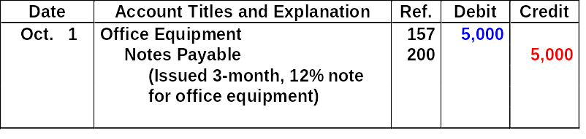
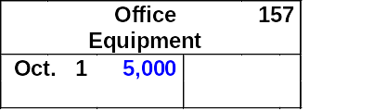

PURCHASE OF OFFICE EQUIPMENT
JOURNAL ENTRY
POSTING

Slide 47
RECEIPT OF CASH FOR FUTURE SERVICE
October 2, a $1,200 cash advance is received from a client, for advertising services expected to be completed by December 31.
Transaction
Asset Cash is increased $1,200
Liability Unearned Fees is increased $1,200
Service has not been rendered yet.
Liabilities often have the word “payable” in their title, Unearned fees are a liability.
Basic
Analysis
Debit-Credit
Analysis
Debits increase assets: debit Cash $1,200. Credits increase liabilities: credit Unearned Fees $1,200.

Slide 48
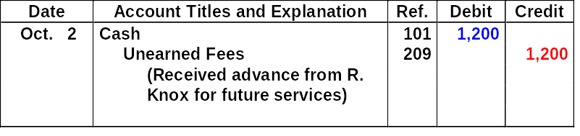
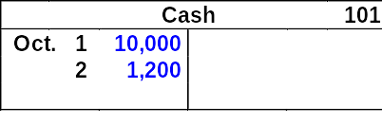

RECEIPT OF CASH FOR FUTURE SERVICE
JOURNAL ENTRY
POSTING

Slide 49
PAYMENT OF MONTHLY RENT
Transaction
October 3, office rent for October is paid in cash, $900.
Basic
Analysis
The expense Rent is increased $900
Payment pertains only to the current month
Asset Cash is decreased $900.
Debit-Credit
Analysis
Debits increase expenses: debit Rent Expense $900. Credits decrease assets: credit Cash $900.

Slide 50
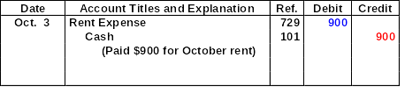


PAYMENT OF RENT EXPENSE
JOURNAL ENTRY
POSTING

Slide 51
PAYMENT FOR INSURANCE
October 4, $600 Paid one-year insurance policy-expires next year on September 30.
Transaction
-Asset Prepaid Insurance increases $600
-Payment extends to more than the current month
-Asset Cash is decreased $600.
-Payments of expenses benefiting more than one period are prepaid expenses or prepayments.
Basic
Analysis
Debit-Credit
Analysis
Debits increase assets: debit Prepaid Insurance $600. Credits decrease assets: credit Cash $600.

Slide 52
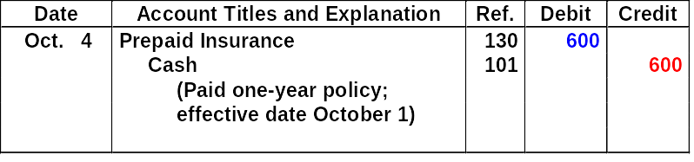



PAYMENT FOR INSURANCE
JOURNAL ENTRY
POSTING

Slide 53
PURCHASE OF SUPPLIES ON CREDIT
October 5, an estimated 3-month supply of advertising materials is purchased on account from Aero Supply for $2,500.
Transaction
Basic
Analysis
The asset Advertising Supplies is increased $2,500; the liability Accounts Payable is increased $2,500.
Debit-Credit
Analysis
Debits increase assets: debit Advertising Supplies $2,500. Credits increase liabilities: credit Accounts Payable $2,500.

Slide 54
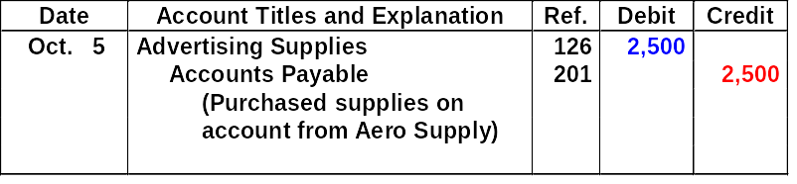


PURCHASE OF SUPPLIES ON CREDIT
JOURNAL ENTRY
POSTING

Slide 55
HIRING OF EMPLOYEES
October 9, hire four employees to begin work on October 15. Each employee is to receive a weekly salary of $500 for a 5-day work week, payable every 2 weeks -- first payment made on October 26.
Transaction
Basic
Analysis
A business transaction has not occurred only an agreement between the employer and the employees to enter into a business transaction beginning on October 15.
Debit-Credit
Analysis
A debit-credit analysis is not needed because there is no accounting entry.

Slide 56
WITHDRAWAL OF CASH BY OWNER
Transaction
October 20, C. R. Byrd withdraws $500 cash for personal use.
Basic
Analysis
The owner’s equity account C. R. Byrd, Drawing is increased $500.
The asset Cash is decreased $500.
Debit-Credit
Analysis
Debits increase drawings: debit C. R. Byrd, Drawing $500. Credits decrease assets: credit Cash $500.

Slide 57
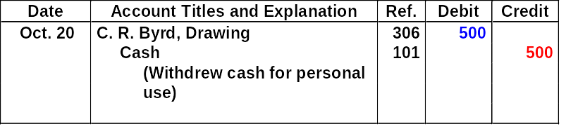


WITHDRAWAL OF CASH BY OWNER
JOURNAL ENTRY
POSTING

Slide 58
PAYMENT OF SALARIES
Transaction
October 26, employee salaries of $4,000 are owed and paid in cash. (See October 9 transaction.)
Basic
Analysis
The expense account Salaries Expense is increased $4,000; the asset Cash is decreased $4,000.
Debit-Credit
Analysis
Debits increase expenses: debit Salaries Expense $4,000. Credits decrease assets: credit Cash $4,000.

Slide 59
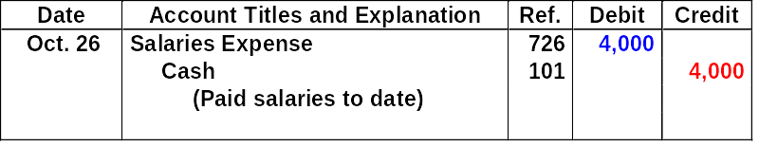



PAYMENT OF SALARIES
JOURNAL ENTRY
POSTING

Slide 60
RECEIPT OF CASH FOR FEES EARNED
October 31, received $10,000 in cash from Copa Company for advertising services rendered in October.
Transaction
Basic
Analysis
The asset Cash is increased $10,000; the revenue Fees Earned is increased $10,000.
Debit-Credit
Analysis
Debits increase assets: debit Cash $10,000. Credits increase revenues: credit Fees Earned $10,000.

Slide 61
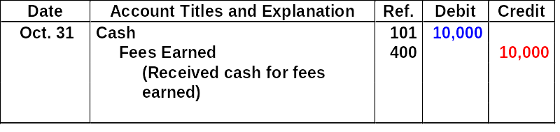


RECEIPT OF CASH FOR FEES EARNED
JOURNAL ENTRY
POSTING

Slide 62
THE TRIAL BALANCE
STUDY OBJECTIVE 7
The trial balance is a list of accounts and their balances at a given time.
The primary purpose of a trial balance is to prove debits = credits after posting.
If debits and credits do not agree, the trial balance can be used to uncover errors in journalizing and posting.

Slide 63
THE TRIAL BALANCE
The Steps in preparing the Trial Balance are:
    List the account titles and balances
    Total the debit and credit columns
    Prove the equality of the two columns

Slide 64
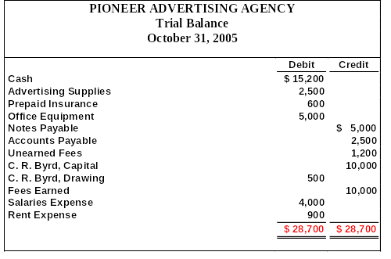
A TRIAL BALANCE
The total debits must equal the total credits.

Slide 65
LIMITATIONS OF A TRIAL BALANCE
A trial balance does not prove all transactions have been recorded or the ledger is correct.
Numerous errors may exist even though the trial balance columns agree. For example, the trial balance may balance even when:
  a transaction is not journalized
  a correct journal entry is not posted
  a journal entry is posted twice
  incorrect accounts used in journalizing or posting
  offsetting errors are made in recording

Slide 66
Which one of the following represents the expanded basic accounting equation?
  Assets = Liabilities + Owner’s Capital + Owner’s Drawings – Revenue - Expenses.
  Assets + Owner’s Drawings + Expenses = Liabilities + Owner’s Capital + Revenue.
  Assets – Liabilities – Owner’s Drawings = Owner’s Capital + Revenue – Expenses.
  Assets = Revenue + Expenses – Liabilities.

Slide 67
Which one of the following represents the expanded basic accounting equation?
  Assets = Liabilities + Owner’s Capital + Owner’s Drawings – Revenue - Expenses.
  Assets + Owner’s Drawings + Expenses = Liabilities + Owner’s Capital + Revenue.
  Assets – Liabilities – Owner’s Drawings = Owner’s Capital + Revenue – Expenses.
  Assets = Revenue + Expenses – Liabilities.

